Slide 1
Products, Services & Branding
Lecture 5

Slide 2

Learning Objectives
8.1 Define product and describe the major classifications of products and services.
8.2 Describe the decisions companies make regarding their individual products, product lines, and product mixes.
8.3 Discuss branding strategy—the decisions companies make in building and managing their brands.
8.4 Identify the four characteristics that affect the marketing of services and the additional marketing considerations that services require.

Slide 3
What Is a Product?
Product is anything that can be offered in a market for attention, acquisition, use, or consumption that might satisfy a need or want.
Service is a product that consists of activities, benefits, or satisfactions and that is essentially intangible and does not result in the ownership of anything.
Notes:
Products include more than just tangible objects, such as cars, computers, or mobile phones. Broadly defined, products also include services, events, persons, places, organizations, ideas, or a mixture of these.
Because of their importance in the world economy, we will look at services more closely later in this chapter. Examples include banking, hotel services, airline travel, retail, wireless communication, and home-repair services.

Slide 4
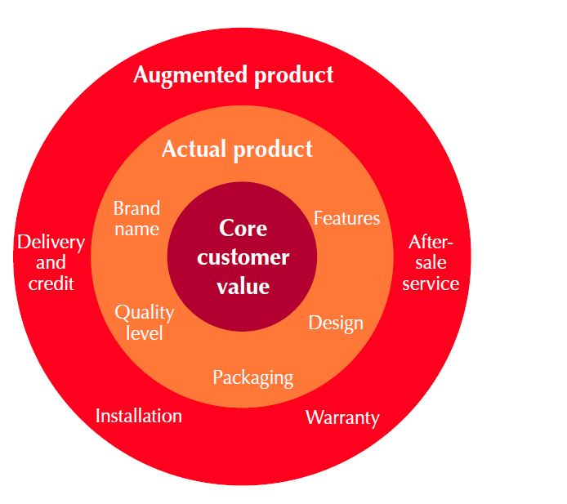
What Is a Product?
Products, Services, and Experiences
Products and services are becoming more commoditized.
Companies are now creating and managing customer experiences with their brands or company.
Three Levels of Product
Notes:
Product planners need to think about products and services on three levels (see Figure 8.1). Each level adds more customer value. The most basic level is the core customer value, which addresses the question: What is the buyer really buying?
At the second level, product planners must turn the core benefit into an actual product. They need to develop product and service features, a design, a quality level, a brand name, and packaging.
Finally, product planners must build an augmented product around the core benefit and actual product by offering additional consumer services and benefits.

Slide 5
Some examples
NUS Undergrad Programs | MUFC | Apple/Samsung smartphone
Core Knowledge skills | Entertainment Loyalty to club | Communications Entertainment Work
Actual Lecturers Facilities – classrooms, library Degree | Players Matches Merchandise | Hardware Software – operating system (iOS / Android) Apps
Augmented Bursary /Scholarships Career Centre | TV screening of matches Supporters’ clubs | Accessories Service centres

Slide 6
What Is a Product?
Product and Service Classifications
Consumer products are products and services bought by final consumers for personal consumption.
Convenience products
Shopping products
Specialty products
Unsought products

Slide 7
What Is a Product?
Product and Service Classifications
Convenience products are consumer products and services that the customer usually buys frequently, immediately, and with a minimum comparison and buying effort.
Usually low priced, and marketers place them in many locations to make them readily available when customers need or want them.
Newspapers
Soap
Fast food
Shopping products are less frequently purchased consumer products and services that the customer compares carefully on suitability, quality, price, and style.
Usually distributed through fewer outlets but provide deeper sales support to help customers in their comparison efforts.
Furniture
Cars
Hotel services

Slide 8
What Is a Product?
Product and Service Classifications
Specialty products are consumer products and services with unique characteristics or brand identification for which a significant group of buyers is willing to make a special purchase effort.
Buyers normally do not compare specialty products. They invest only the time needed to reach dealers carrying the wanted products.
Medical services
Specific types of cars
High-end electronics
Unsought products are consumer products that the consumer does not know about or knows about but does not normally think of buying.
Life insurance??
Funeral services
Blood donations

Slide 9
Marketing Considerations for Consumer Products
Table 8.1 Marketing Considerations for Consumer Products
Marketing Considerations | Type of Consumer Product Convenience | Type of Consumer Product Shopping | Type of Consumer Product Specialty | Type of Consumer Product Unsought
Customer buying behavior | Frequent purchase; little planning, little comparison or shopping effort; low Customer involvement | Less frequent purchase; much planning and shopping effort; comparison of brands on price, quality, and style | Strong brand preference and loyalty; special purchase effort; little comparison of brands; low price sensitivity | Little product awareness or knowledge (or, if aware, little or even negative interest)
Price | Low price | Higher price | High price | Varies

Slide 10
Marketing Considerations for Consumer Products
Table 8.1 [continued]
Marketing Considerations | Type of Consumer Product Convenience | Type of Consumer Product Shopping | Type of Consumer Product Specialty | Type of Consumer Product Unsought
Distribution | Widespread distribution; Convenient locations | Selective distribution in fewer outlets | Exclusive distribution in only one or a few outlets per market area | Varies
Promotion | Mass promotion by the producer | Advertising and personal selling by both the producer and resellers | More carefully targeted promotion by both the producer and resellers | Aggressive advertising and personal selling by the producer and resellers
Examples | Toothpaste, magazines, and laundry detergent | Major appliances, televisions, furniture, and clothing | Luxury goods, such as Rolex watches or fine crystal | Life insurance and Red Cross blood donations

Slide 11
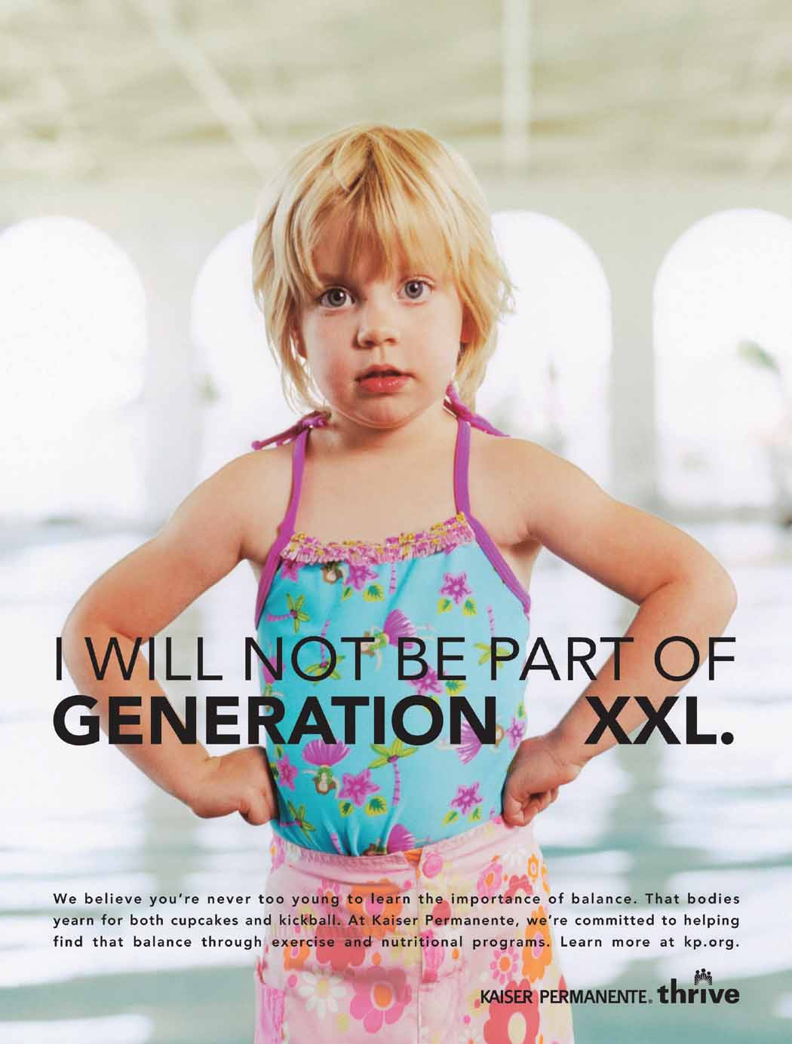
What Is a Product?
Product and Service Classifications
Organizations, Persons, Places, and Ideas
Organization marketing
Person marketing
Place marketing
Social marketing

Slide 12
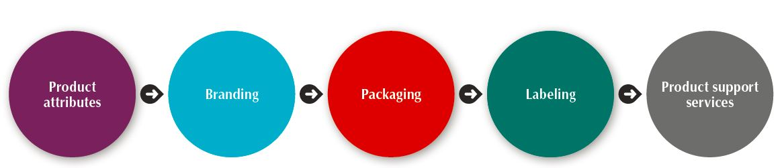
Product Decisions
Individual Product Decisions
Figure 8.3 Individual Product Decisions

Slide 13
Product and Service Decisions
Individual Product and Service Decisions
Communicate and deliver benefits by product and service attributes.
Quality
Features
Style and design

Slide 14
Product and Service Decisions
Individual Product and Service Decisions
Product Features
Competitive tool for differentiating a product from competitors’ products
Assessed based on the value to the customer versus its cost to the company

Slide 15


Product and Service Decisions
Individual Product and Service Decisions
Style describes the appearance of the product.
Design contributes to a product’s usefulness as well as to its looks.

Slide 16
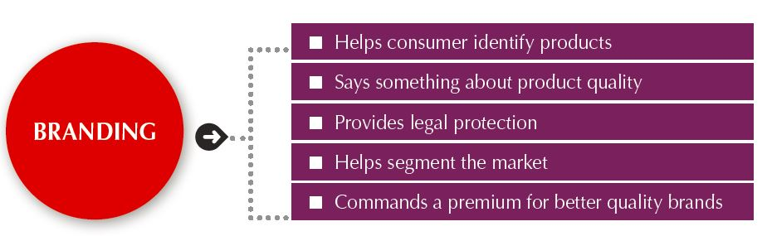
Product and Service Decisions
Individual Product and Service Decisions
Brand is the name, term, sign, or design or a combination of these, that identifies the maker or seller of a product or service.

Slide 17
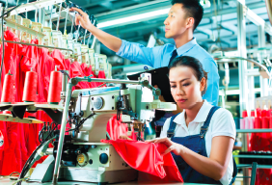
Product and Service Decisions
Individual Product and Service Decisions
Packaging involves designing and producing the container or wrapper for a product.
Labels identify the product or brand, describe attributes, and provide promotion.

Slide 18
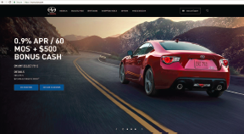
Product and Service Decisions
Individual Product and Service Decisions
Product support services augment actual products.
Support services are an important part of the customer’s overall brand experience. Keeping customers happy after the sale is the key to building lasting relationships.

Slide 19
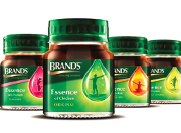
Product and Service Decisions
Product Line Decisions
Product line is a group of products that are closely related because they function in a similar manner, are sold to the same customer groups, are marketed through the same types of outlets, or fall within given price ranges.
Product line length is the number of items in the product line.
Line stretching
Line filling
Notes:
The major product line decision involves product line length—the number of items in the product line. The line is too short if the manager can increase profits by adding items; the line is too long if the manager can increase profits by dropping items. Managers need to analyze their product lines periodically to assess each item’s sales and profits and understand how each item contributes to the line’s overall performance.
Product line stretching and filling: BRAND’S®, a leading health enrichment player in Asia, credits consumercentric innovation as key to its success, enabling a diverse portfolio that caters to different and evolving consumers’ needs.
A company can expand its product line in two ways: by line filling or line stretching. Product line filling involves adding more items within the present range of the line for earning extra profits, satisfying dealers, using excess capacity, being the leading full-line company, and plugging holes to keep out competitors. However, line filling is overdone if it results in cannibalization and customer confusion. The company should ensure that new items are noticeably different from existing ones.
Product line stretching occurs when a company lengthens its product line beyond its current range − downward, upward, or both ways.
Companies located at the upper end of the market can stretch their lines downward. A company may stretch downward to plug a market hole that otherwise would attract a new competitor or respond to a competitor’s attack on the upper end. Or it may add low-end products because it finds faster growth taking place in the low-end segments.
Companies can also stretch their product lines upward. Sometimes, companies stretch upward to add prestige to their current products. Or they may be attracted by a faster growth rate or higher margins at the higher end.

Slide 20
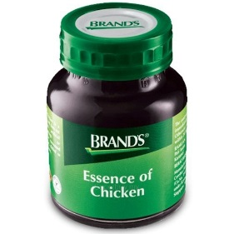
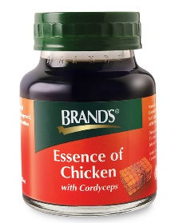
PRODUCT LINE DECISIONS
Lines usually lengthen over time to:
Satisfy consumers
Increase sales & profits
Brands: From basic Chicken Tonic to Gingko Nuts/Cordyceps Chicken Tonic
Line stretching – lengthening line beyond current range
e.g., introducing more expensive/cheaper versions of shampoos
Line filling – lengthening line within current range
e.g., introducing more different scents of shampoos
Lower end
Higher end
Stretch upwards

Slide 21
Product and Service Decisions
Product Mix Decisions
Product mix consists of all the product lines and items that a particular seller offers for sale.
Width - number of different product lines the company carries.
Length - total number of items the company carries within its product lines.
Depth - number of versions offered of each product in the line.
Consistency - how closely the various product lines are in end use, production requirements, or distribution channels.
From time to time, a company may also have to streamline its product mix to pare out marginally performing lines and models and to regain its focus.

Slide 22
Branding Strategy: Building Strong Brands
Brand Equity and Brand Value
Brand equity is the differential effect that knowing the brand name has on customer response to the product or its marketing.
Brand value is the total financial value of a brand.
Notes:
Brands are more than just names and symbols. They are a key element in the company’s relationships with consumers. Brands represent consumers’ perceptions and feelings about a product and its performance—everything that the product or the service means to consumers.
A powerful brand has high brand equity. It’s a measure of the brand’s ability to capture consumer preference and loyalty. A brand has positive brand equity when consumers react more favorably to it than to generic or unbranded products.
Ad agency Young & Rubicam’s BrandAsset Valuator measures brand strength along four consumer perception dimensions: differentiation, relevance, knowledge, and esteem. Brands with strong brand equity rate high on all four dimensions.
Positive brand equity derives from consumer feelings about and connections with a brand. Strong brands are built around an ideal of improving consumers’ lives in some relevant way.
A brand with high brand equity is a very valuable asset. Brand valuation is the process of estimating the total financial value of a brand. Measuring such value is difficult. However, according to one estimate, the brand value of Apple is $170 billion, Google is $120 billion, and Coca-Cola is $78 billion. Other brands that rate among the world’s most valuable include Microsoft, IBM, Toyota, Samsung, McDonald’s, and Amazon.
High brand equity provides a company with many competitive advantages:
high level of consumer brand awareness and loyalty
more leverage in bargaining with resellers
easier launch of line and brand extensions
defense against fierce price competition
A powerful brand forms the basis for building strong and profitable customer relationships. The fundamental asset underlying brand equity is customer equity—the value of customer relationships that the brand creates. Companies need to think of themselves not as portfolios of brands but as portfolios of customers.

Slide 23
Examples of famous brands
Notes:
Hidden logo meanings
https://digitalsynopsis.com/design/famous-brand-logos-hidden-meanings/

Slide 24
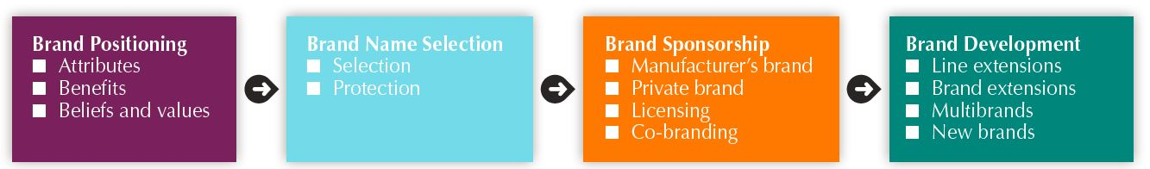
Branding Strategy: Building Strong Brands
Building Strong Brands
Figure 8.6 Major Brand Strategy Decisions
Notes:
Branding poses challenging decisions to the marketer. Figure 8.6 shows that the major brand strategy decisions involve brand positioning, brand name selection, brand sponsorship, and brand development.

Slide 25
Branding Strategy: Building Strong Brands
Building Strong Brands
Brand Positioning
Marketers can position brands at any of three levels.
Attributes
Benefits
Beliefs and values
Notes:
Marketers need to position their brands clearly in target customers’ minds. They can position brands at any of three levels.
At the lowest level, they can position the brand on product attributes. For example, P&G’s Pampers’ early marketing focused on attributes such as fluid absorption, fit, and disposability. Attributes are the least desirable level for brand positioning because competitors can easily copy attributes. Customers are not interested in what the attributes are—they are interested in what the attributes will do for them.
A brand can be better positioned by associating its name with a desirable benefit. Thus, Pampers can go beyond technical product attributes and talk about the resulting containment and skin-health benefits from dryness.
The strongest brands are positioned on strong beliefs and values, engaging customers on a deep, emotional level. For example ,Pampers is positioned as a “love, sleep, and play brand where we grow together” that’s concerned about happy babies, parent-child relationships, and total baby care.
Successful brands engage customers on a deep, emotional level. Brands ranging from Apple, Google, Disney, and Coca-Cola to Google and Pinterest have achieved this status with many of their customers. Customers don’t just like these brands. They have strong emotional connections with them and love them unconditionally.
When positioning a brand, the marketer should establish a mission for the brand and a vision of what the brand must be and do. A brand is the company’s promise to deliver a specific set of features, benefits, services, and experiences consistently to buyers. The brand promise must be simple and honest

Slide 26
Branding Strategy: Building Strong Brands
Building Strong Brands
Brand Name Selection
Suggests benefits and qualities
Easy to pronounce, recognize, and remember
Distinctive
Extendable
Translatable for the global economy
Notes:
Desirable qualities for a brand name include the following.
(1) It should suggest something about the product’s benefits and qualities: iPhone, Walkman, Scoot.
(2) It should be easy to pronounce, recognize, and remember: Kao, Wii, Za.
(3) The brand name should be distinctive: Qoo, Lexus.
(4) It should be extendable—Amazon.com began as an online bookseller but chose a name that would allow expansion into other categories.
(5) The name should translate easily into foreign languages. Hyatt does not translate easily and confers no meaning in China. So the company used the name “Yue” (悦) which means “Imperial,” an identification which many Chinese aspire to be aligned with.

Slide 27
Branding Strategy: Building Strong Brands
Building Strong Brands
Brand Sponsorship
Manufacturer’s brand
Private brand
Licensed brand
Co-brand
Notes:
The popularity of store brands has soared recently. Walmart’s store brands account for a whopping 25 percent of its sales, and its Great Value brand is the nation’s largest single food brand.
A manufacturer has four brand sponsorship options. The product may be launched as a national brand or a private brand (also called a store brand or distributor brand). Other alternatives include a licensed brand and co-branding.
Manufacturers’ brands have long dominated the retail scene. In recent times, however, an increasing number of retailers and wholesalers have created their own store brands (or private brands). Store brands have been gaining strength for more than two decades, but recent tighter economic times have created a store-brand boom.
For example, Hong Kong’s Watsons convenience store chain has branded bottled water, swabs, tissue paper, and other sundries under its own name. A Nielsen survey found that 74% of Singaporeans polled found private brands extremely good value for money, while 55% found the quality to be at least on par with the big brands.
Consumers are becoming loyal to store brands for reasons besides price. Recent research showed that 80 percent of all shoppers believe store brand quality is equal to or better than that of manufacturer’s brands.
Licensing: Some companies license names or symbols previously created by other manufacturers, names of well-known celebrities, or characters from popular movies and books. For a fee, any of these can provide an instant and proven brand name.
Co-branding occurs when two established brand names of different companies are used on the same product. Co-branding offers many advantages. Because each brand operates in a different category, the combined brands create broader consumer appeal and greater brand equity. An Example includes American Express and Singapore Airlines.
Co-branding can take advantage of the complementary strengths of two brands. It also allows a company to expand its existing brand into a category it might otherwise have difficulty entering alone.
Co-branding has limitations and usually involves complex legal contracts and licenses. Co-branding partners must carefully coordinate their marketing mix, and each partner must trust that the other will take good care of its brand. If something damages the reputation of one brand, it can tarnish the co-brand as well.

Slide 28
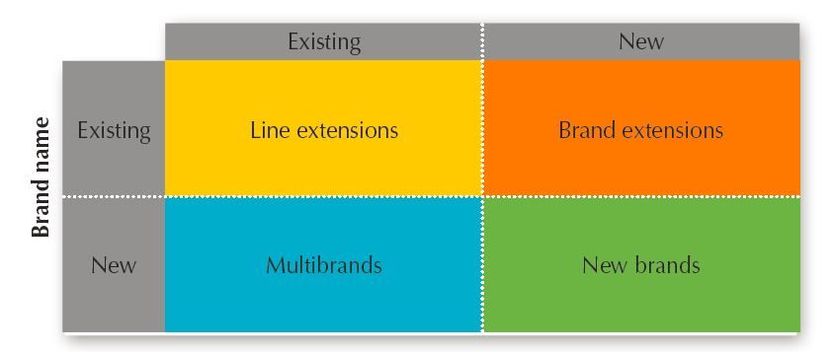
Branding Strategy: Building Strong Brands
Building Strong Brands
Figure 8.7 Brand Development Strategies
Notes:
A company has four choices when it comes to brand development (see Figure 8.7). It can introduce line extensions, brand extensions, multibrands, or new brands.
Line extensions occur when a company extends existing brand names to new forms, colors, sizes, ingredients, or flavors of an existing product category. For example, the original Hershey’s Kisses has morphed into a full line of Kisses like Rich Dark Chocolate Hershey’s Kisses and a dozen others, making the original brand seem like just another flavor. A line extension works best when it takes sales away from competing brands, not when it “cannibalizes” the company’s other items.
Brand extension extends a current brand name to new or modified products in a new category. For example, Kimberly-Clark extended its market-leading Huggies brand from only disposable diapers to a full line of toiletries for tots, from shampoos, lotions, and diaper-rash ointments to baby wash, disposable washcloths, and disposable changing pads.
Multi-brands: Companies often market many different brands in a given product category. For example, P&G markets many different brands in each of its product categories. Multibranding allows a company to lock up more reseller shelf space. L’Oréal markets at least 14 different brands in China, grouping them in various pricing bands. Luxury brands are priced at a premium; semi-selective brands such as L’Oréal Paris at a lower premium; followed by more mass-market distributed brands like Garnier; and finally, economical brands such as Mininurse. L’Oréal finds that in China, pricing can be stretched further apart than elsewhere.
New brands: A company might believe that the power of its existing brand name is waning, so a new brand name is needed. Or it may create a new brand name when it enters a new product category for which none of its current brand names are appropriate. For example, Toyota created the separate Lexus brand aimed at luxury car consumers and the Scion brand, targeted toward Millennial consumers.
As with multi-branding, offering too many new brands can result in a company spreading its resources too thin. And in some industries, such as consumer packaged goods, consumers and retailers have become concerned that there are already too many brands, with too few differences between them.
Thus, P&G and other large consumer-product marketers are now pursuing megabrand strategies—weeding out weaker or slower-growing brands and focusing their marketing dollars on brands that can achieve the number-one or number-two market share positions with good growth prospects in their categories.

Slide 29
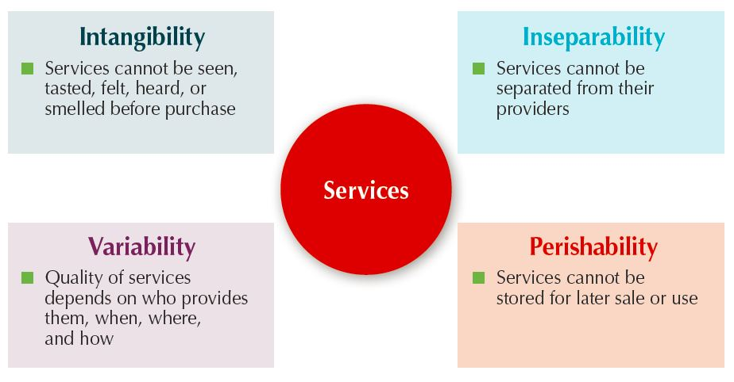
Services Marketing
Nature and Characteristics of a Service
Four Service Characteristics

Slide 30
Services Marketing
Marketing Strategies for Service Firms
In addition to traditional marketing strategies, service firms often require additional strategies.
Service–profit chain
Internal marketing
Interactive marketing

Slide 31
Services Marketing
Marketing Strategies for Service Firms
Service-profit chain links service firm profits with employee and customer satisfaction.
Internal service quality
Satisfied and productive service employees
Greater service value
Satisfied and loyal customers
Healthy service profits and growth

Slide 32
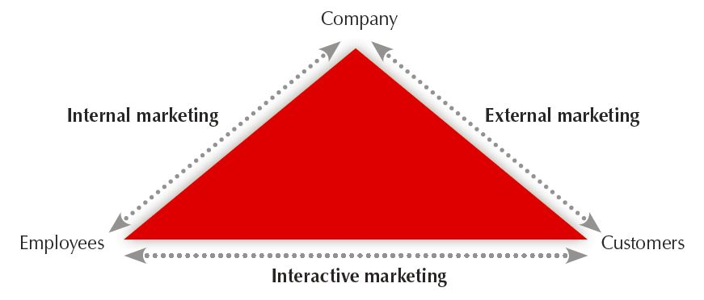
Three Types of Service Marketing
Figure 8.9 Three Types of Service Marketing

Slide 33
Services Marketing
Marketing Strategies for Service Firms
Internal marketing means that the service firm must orient and motivate its customer-contact employees and supporting service people to work as a team to provide customer satisfaction.

Slide 34
Services Marketing
Marketing Strategies for Service Firms
Interactive marketing means that service quality depends heavily on the quality of the buyer-seller interaction during the service encounter.
Service differentiation
Service quality
Service productivity

Slide 35
Services Marketing
Marketing Strategies for Service Firms
Managing service differentiation creates a competitive advantage through : offer, delivery and/or image
Managing service quality enables a service firm to differentiate itself by delivering consistently higher quality than its competitors provide.
Managing service productivity refers to the cost side of marketing strategies for service firms.
Employee hiring and training
Service quantity and quality

